Slide 1
Sick or Not
January
2026
Aima Ayaz
Trevon Woods
Mohammed Abdullah
Capstone Project Proposal
ITAI - 2277
Waseem Basit

Slide 2
CONTENTS
01. Problem Statement
02. Solution
03. Technical Approach
04. Data Plan
05. System Design
06. Success Metrics
07. Challenges
08. Milestones

Slide 3
Problem Statement
During moments in history similar to 2019-2022 when Covid 19 ran rampant throughout the world. Tools like this could be a way to determine whether an individual’s body temperature is abnormal. This could be an indication that they are sick or, if they show no symptoms, they are becoming sick or have some other underlying issue. This could remove the physical aspect of a doctor taking someone’s temperature.

Slide 4
Solution
We propose training an AI system to understand body temperature allowing it to determine if a person is sick or not.

Slide 5
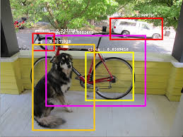

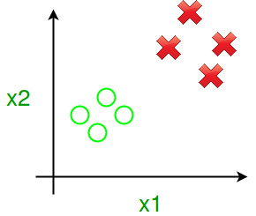
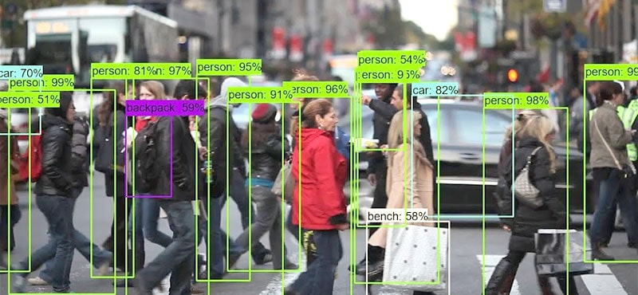
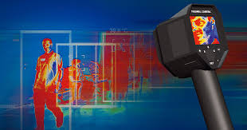
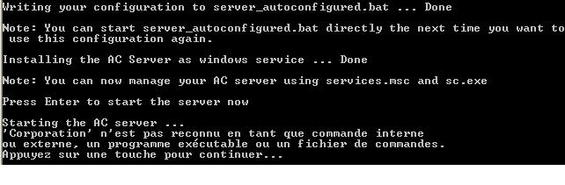
NOTE 2
NOTE 3
Technical Approach
NOTE 4
NOTE 5
NOTE 6
NOTE 1
Train a binary classifier on body temperature data.
Train Yolo to detect person using the system.
Set up temperature overlay for persons body.
Send temperature data to model and show prediction on whether the person’s body temperature is abnormal or not.
Start up a server to manage the AI components and cameras.
Run object detection and Overlay temperature on persons body.

Slide 6
Data Plan
First option to find data
Hugging Face
Second best place to get data
Kaggle
Random dataset from somewhere else on the internet if we can’t find sufficient data on the previous two.
Internet

Slide 7
System Design
Video Stream→Object Detection→Temperature Overlay→Temperature Stream→ System Prediction

Slide 8
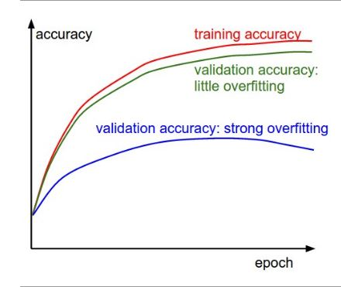
Success Metrics
Accuracy will be our main metric of measurement. We will also use Precision, Recall, and F1 Score for additional insight.

Slide 9
Challenges
The main aspect of this project that will be a challenge is processing the video stream efficiently and creating the temperature overlay.
What aspects of the system that may take a lot of trial and error.

Slide 10
Milestones
Week 1. Meet Group
Week 2. Discuss Project
Week 3. Create Proposal
Week 4. Search Datasets
Week 5. Data Pipeline Creation
Week 6. Data Analysis
Week 7. Model Architecture Design
Week 8. Training
Week 9. Evaluation
Week 10. App Development
Week 11. System Test
Week 12. Deployment Preparation
Week 13. Project Finalization
Week 14. Prepare Presentation
Week 15. Showcase

Slide 11
THANK YOU!

